Slide 1
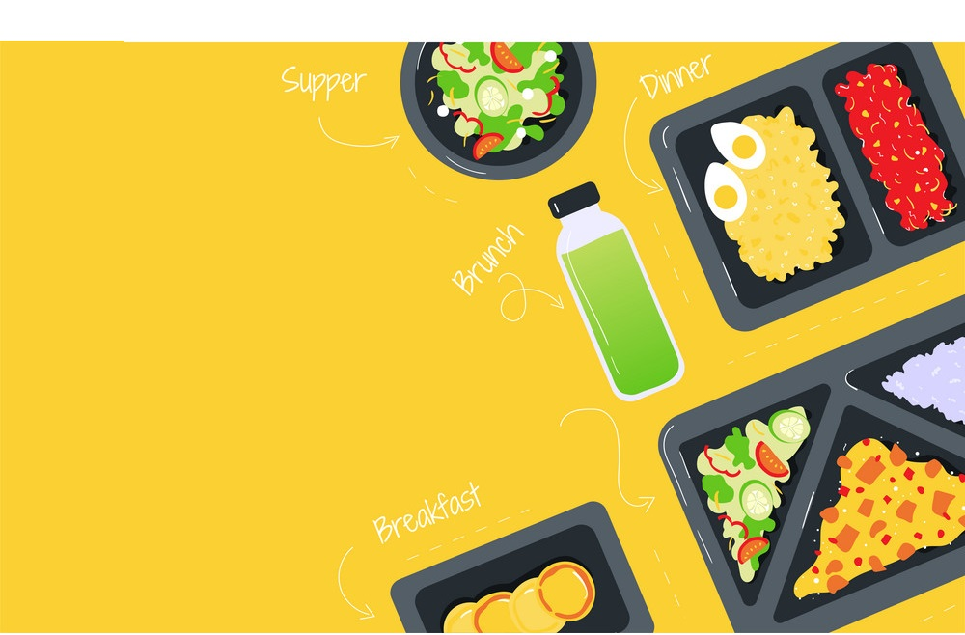
Online Food Delivery System

Slide 2
Team Distribution
s.no Emp-id Name
1 2499017 Dakarapu Sahitya
2 2499055 Shilpa Sagoriya
3 2499102 Md Gulam Sarwar (Team lead)
4 2499255 Yogesh Dhananjay Parekar
5 2479786 Kamalesh Kumar Yadav
6 2499259 Shaik Shazma Thamkeen
7 2499321 J Naveen
8 2499828 Vinod Bhauraoji Ambatkar
9 2499849 Gaddagunta Yuva Madhuri

Slide 3
Index
Introduction
Abstract
Tools and Technologies used
Project Flow
Database design
Application Modules
Testing output
Postman
Advantages
Future Work
Conclusion

Slide 4
INTRODUCTION
The labour rates are increasing steadily year on year thus making it difficult to find employees. The food industry is highly labour intensive and the biggest expense in the food industry is the cost of employing the right kind of people to do the work.
One of the ways to reduce this expense is to use modern technology to replace some of the jobs done by human beings and make machines do the work.
Here we propose an “Online Food Ordering System” that has been designed for Fast Food restaurant, Take-Out or College Cafeterias.
The system can also be used in any food delivery industry. This simplifies the process of food ordering for
both the customer and the restaurant, as the entire process of taking orders is automated.

Slide 5
ABSTRACTION
An Online Food Ordering System is proposed here which simplifies the food ordering process. The proposed system shows an user interface and update the menu with all available options so that it eases the customer work.
Customer can choose more than one item to make an order and can view order details before logging off. The order confirmation is sent to the customer.
The order is placed in the queue and updated in the database and returned in real time. This system assists the staff to o through the orders in real time and process it efficiently with minimal errors.

Slide 6
TECHNOLOGY USED
Java : All the business logic has been written in Java
MySQL : MySQL database has been used as database for the project
Server-side: Spring Boot, Spring Cloud, Spring Data JPA
Database: MySQL
Server: Embedded Tomcat
DevOps: Docker, Git Hub
Cloud Service: AWS ECS (Optional)

Slide 7
ENVIRONMENTS
•Server-side: Spring Boot, Spring Cloud, Spring Data JPA
•Database: MySQL
•Server: Embedded Tomcat
•DevOps: Docker, Git Hub
•Cloud Service: AWS ECS (Optional)

Slide 8
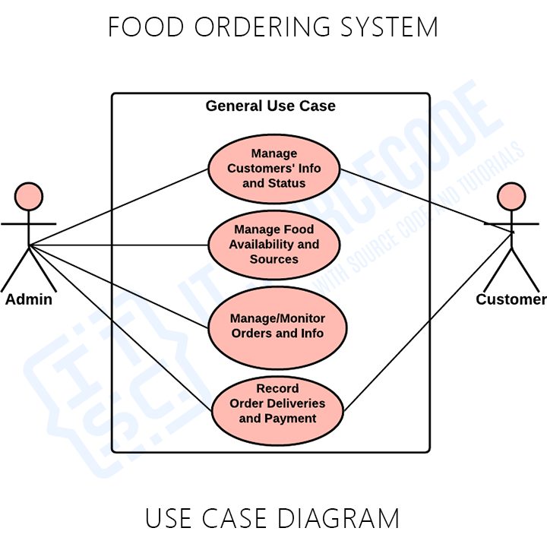
PROJECT FLOW

Slide 9
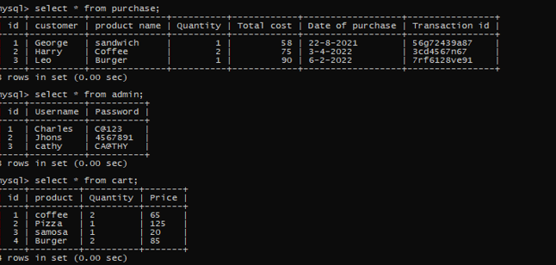
DATABASE DESIGN

Slide 10
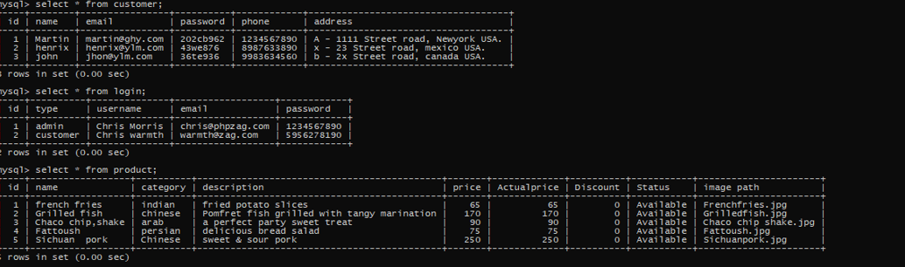
DATABASE DESIGN

Slide 11
MODULES OF ONLINE FOOD DELIVERY SYSTEM
Online Food Delivery System is divided into 6 modules:
1) Admin Module
2) login Module
3) customer Module
4) product Module
5) cart Module
6) Purchase Module

Slide 12
.
Admin Module
Admin login thorugh his/her user name and password to the application and can get all details in the application and also do any changes in the application
Login to the portal
Admin can add/remove products from th application
Update the details of customers and customer orders/purchases.
Admin can view all the details and do any changes in application.
Admin can view the cart and can view the status of products in the cart.

Slide 13
User Module
In User login Module user/customer login thorugh the registerd username and password if the user is registered user or else user login with email id and password for registration in to the application.
Register to the application
Login to the application
Search for the available Products

Slide 14
.
Customer Module
In customer module customer login into the application with thier user name and password and also customer phone number and adress .
Login to the application
Search for the available Products
Add Products to the cart
can view the status of products
purchase the products

Slide 15
Product Module
In product module customer/admin login into the application with thier user name and password and check the products
admin/customer can view products and prices
admin/customer Search for the availability of Products
admin/customer can view the product comes under which category
admin/customer can view the discount and actual price of that product
admin/customer can view the status of the product and image path also

Slide 16
.
Cart Module
In cart module customer once login into the application with thier user name and password and check the products and add them into the cart
customer Search for the availability of Products
customer can add/view the prodcuts into the cart
customer can view the Quantity of the product
admin/customer can view the status of the product in the cart

Slide 17
Purchase Module
In Purchase module customer once login into the application with thier user name and password and check the products
admincustomer can view product names and place the order/purchase
admin/customer can view the Quantity of the purchased product
admin/customer can view the total cost of the product
admin/customer can view the product date of purchase
admin/customer can view the status of the product transaction id

Slide 18
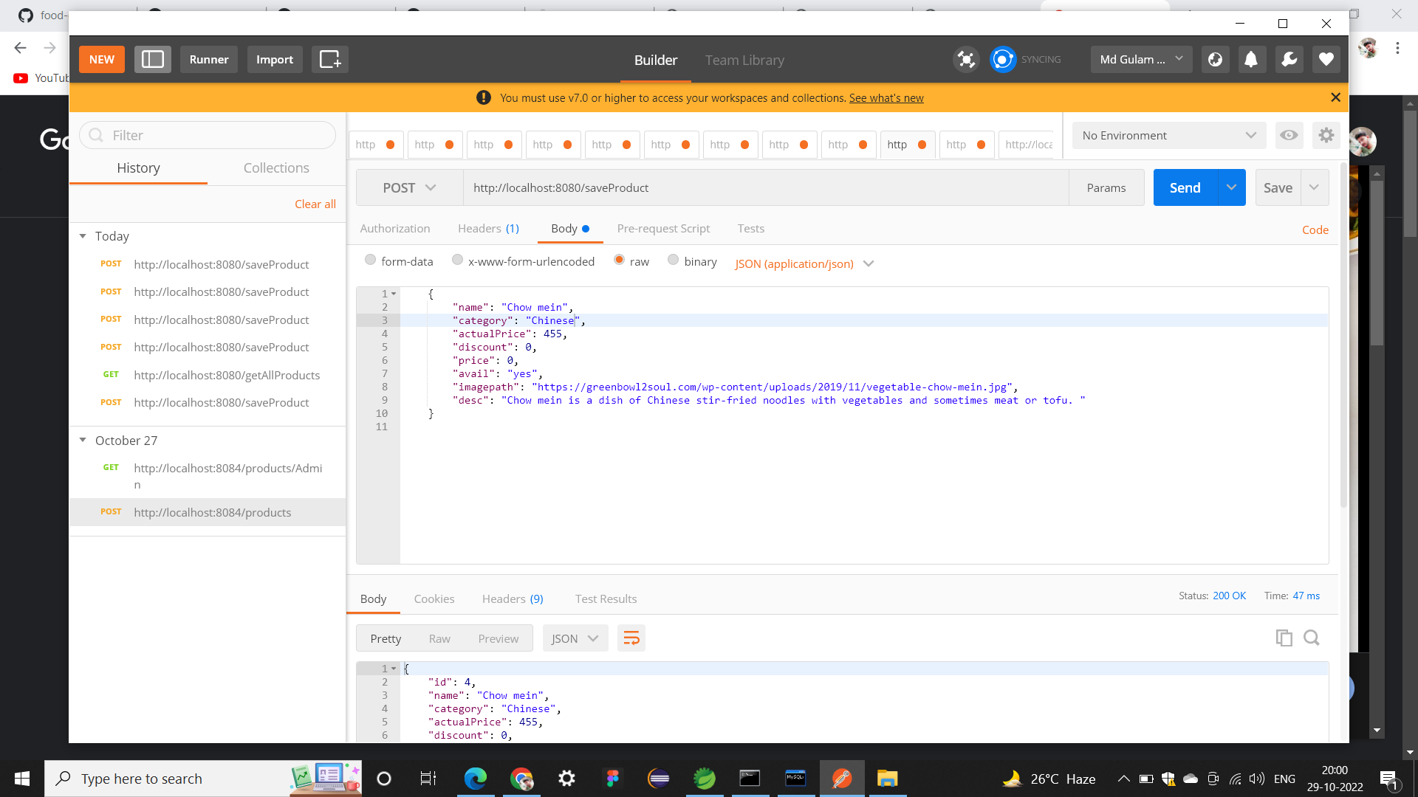
POSTMAN Screenshots

Slide 19
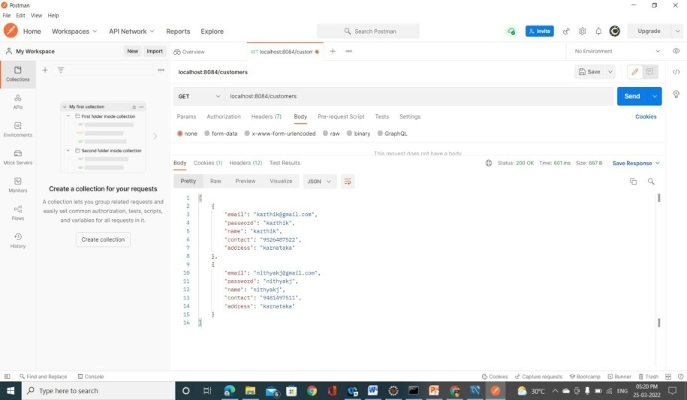

Slide 20
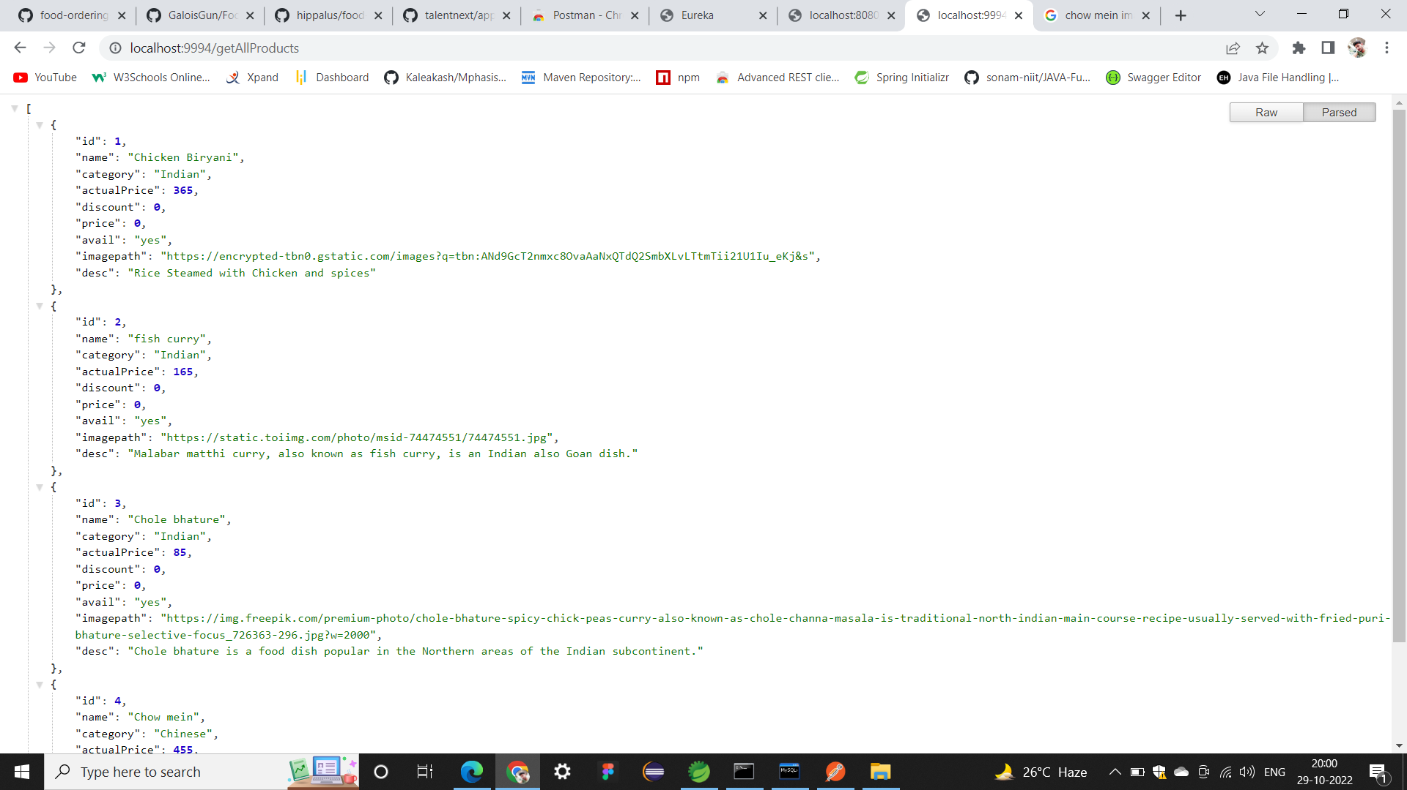

Slide 21
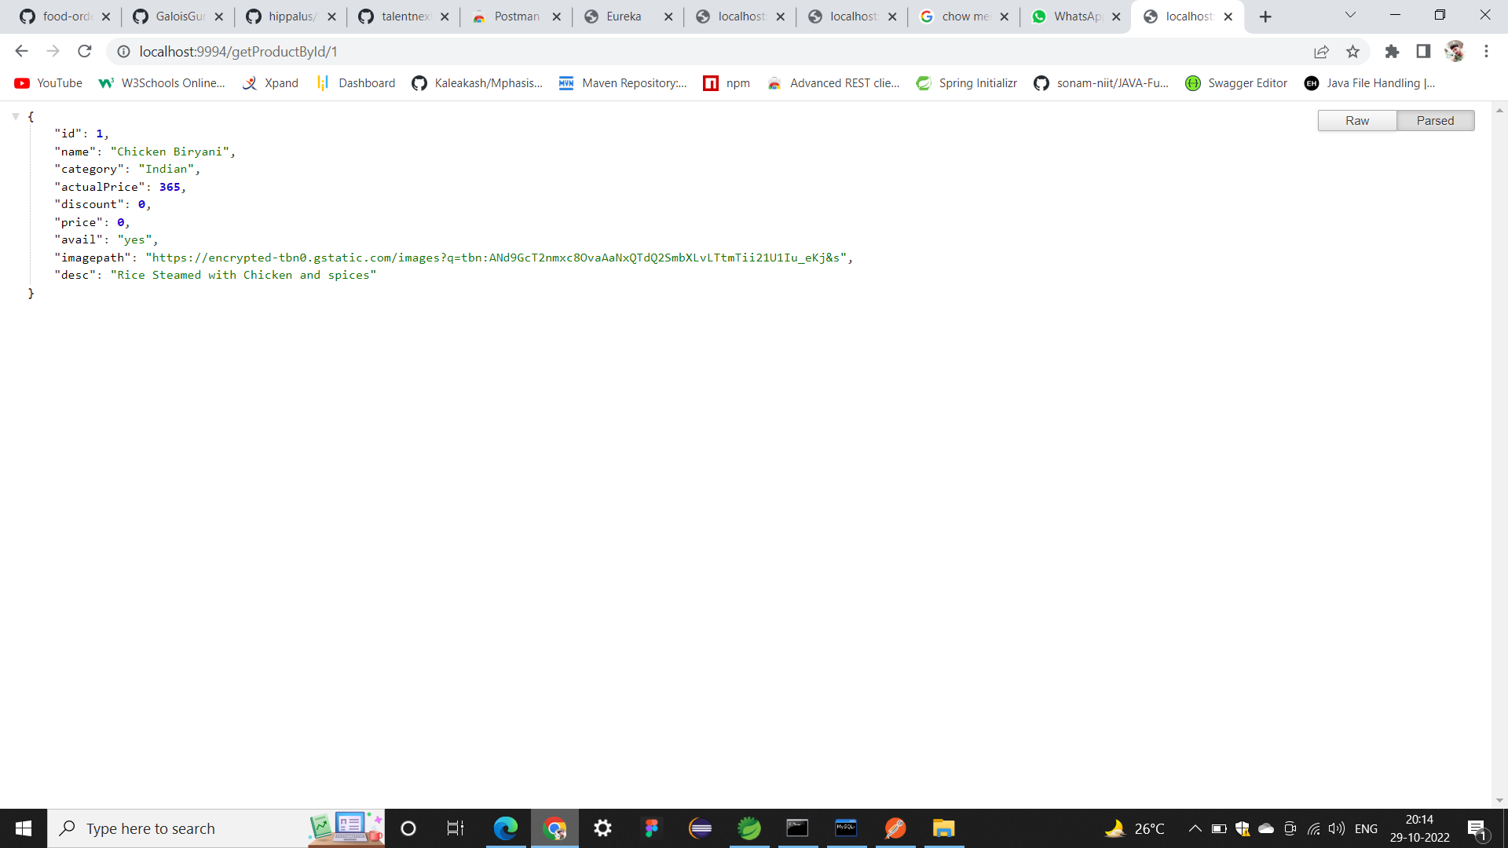
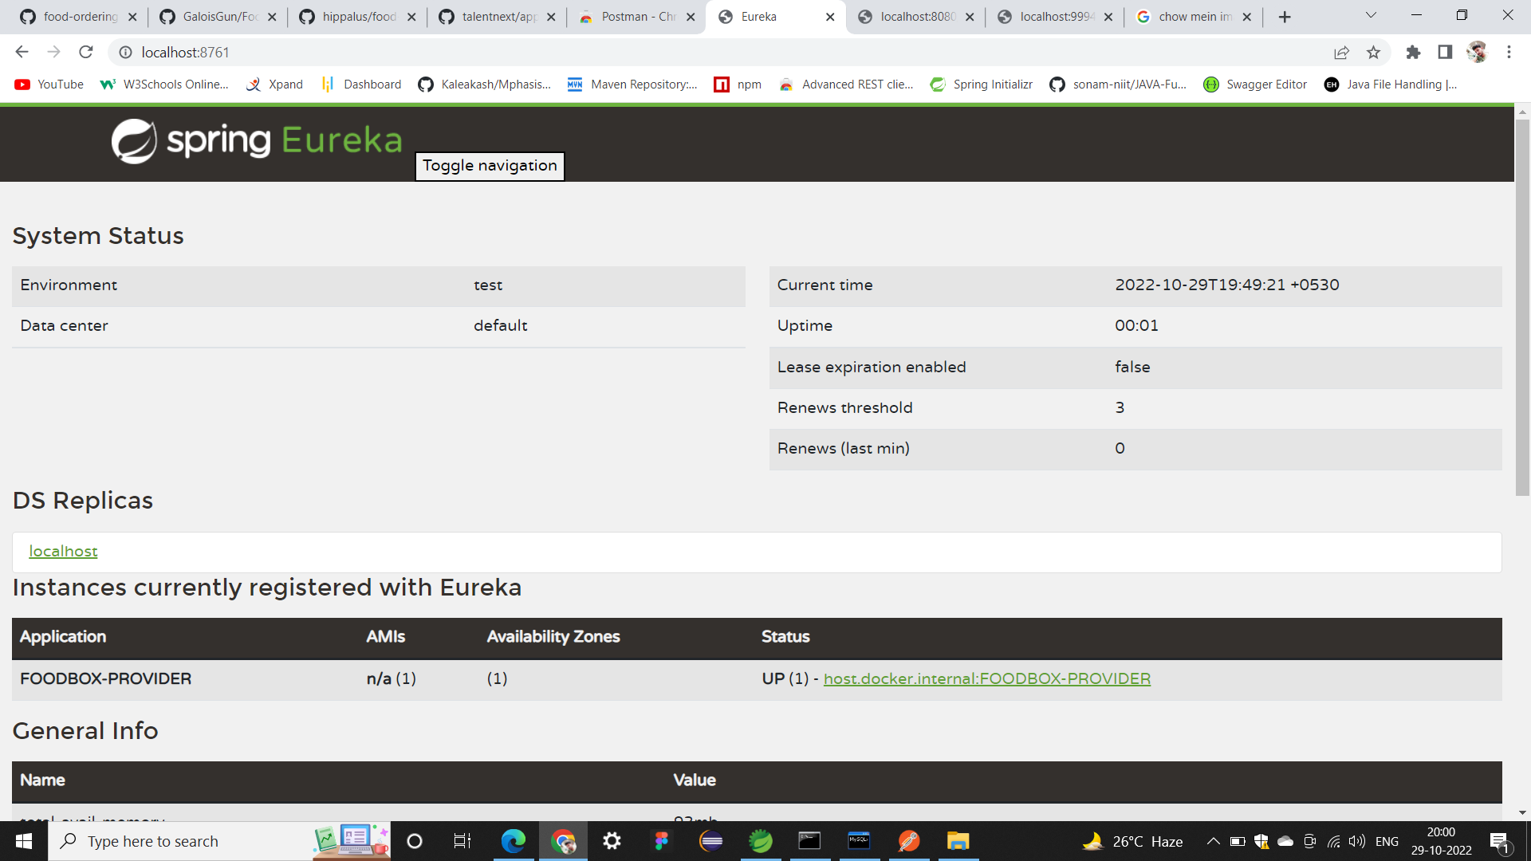

Slide 22
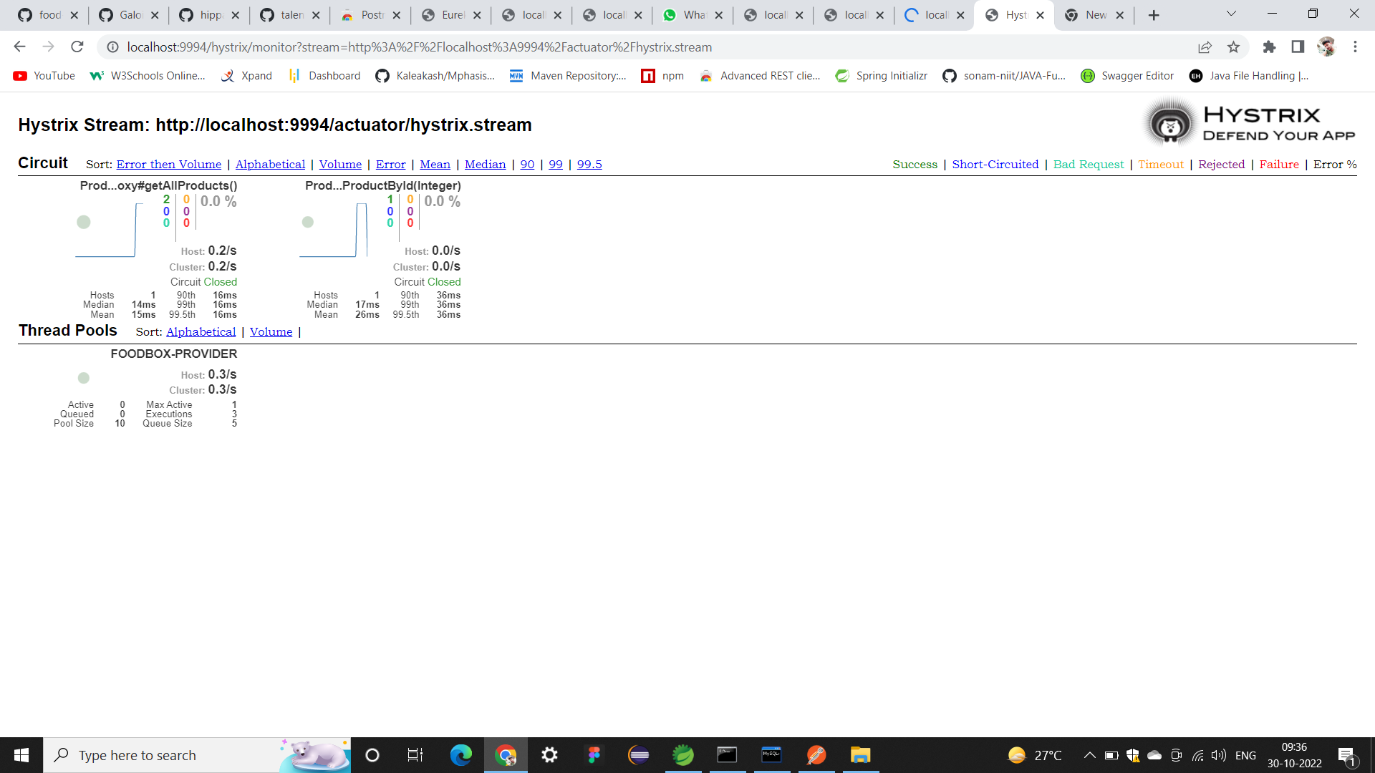
HSTRIX Screenshots

Slide 23
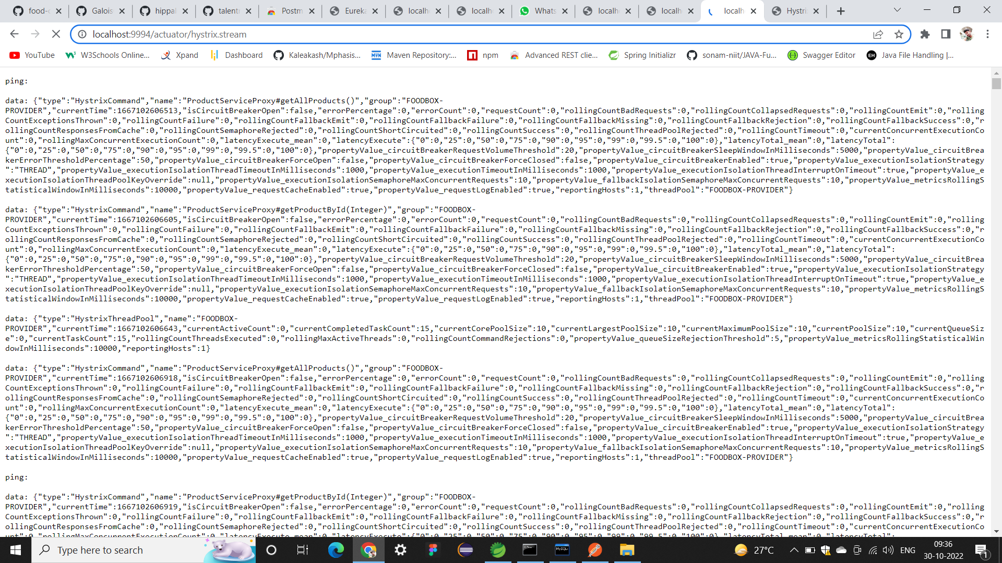

Slide 24
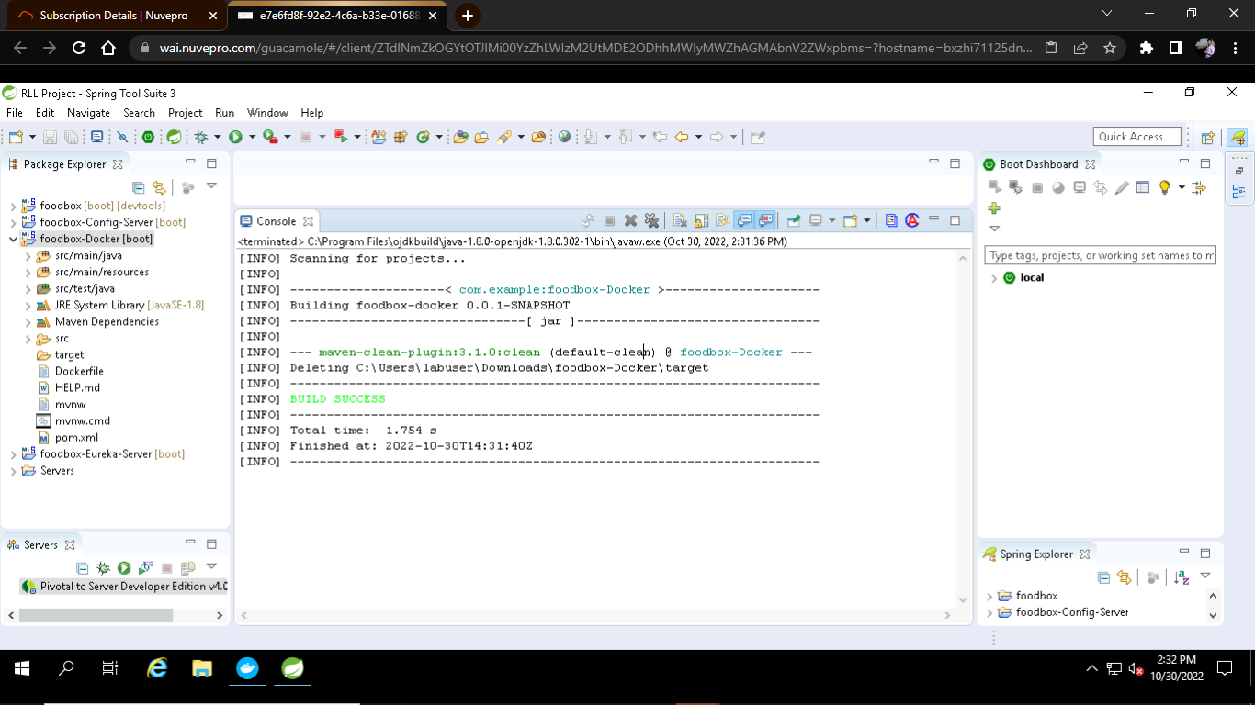
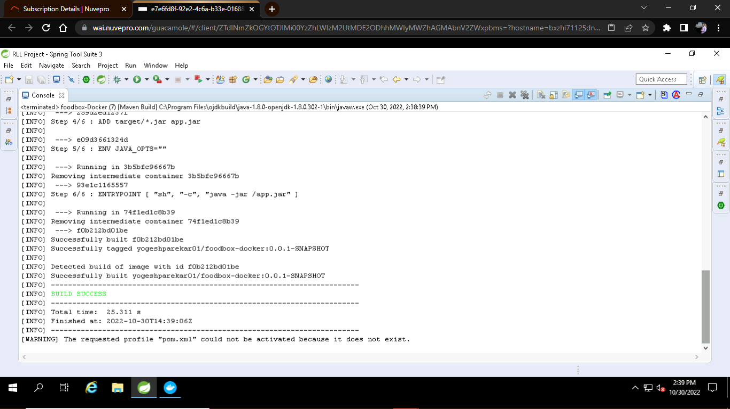
Docker screenshots

Slide 25
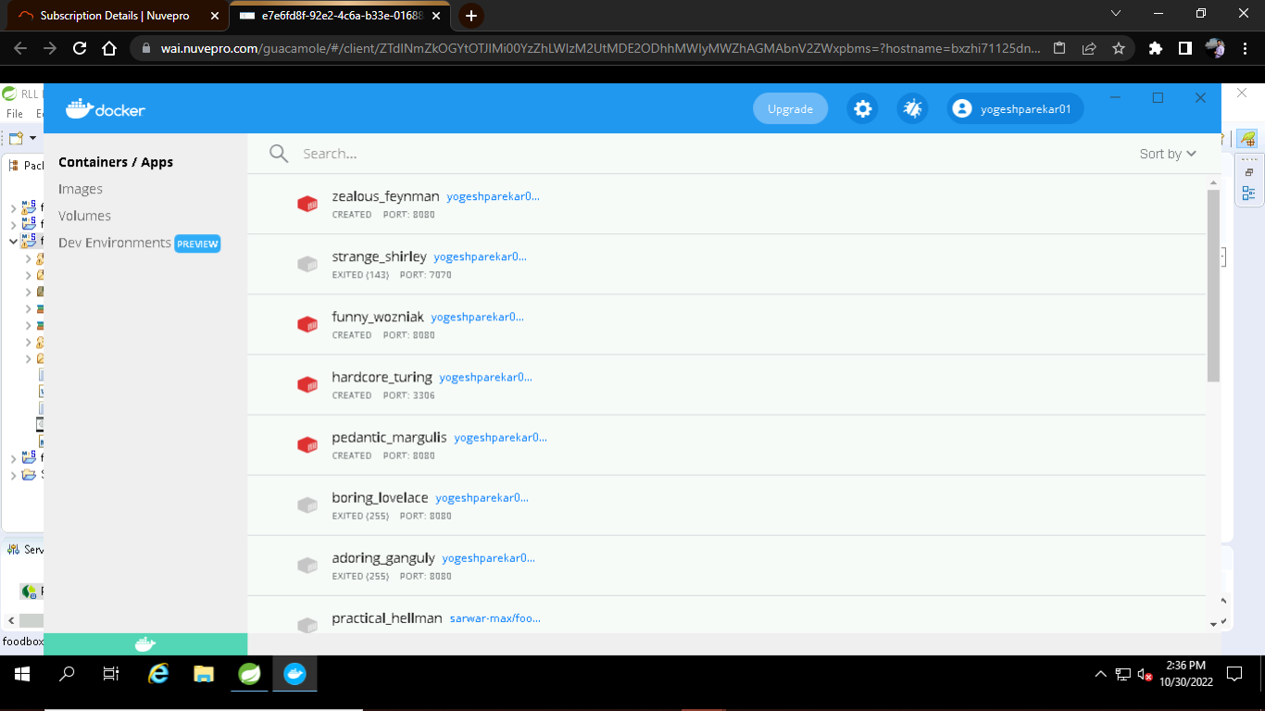
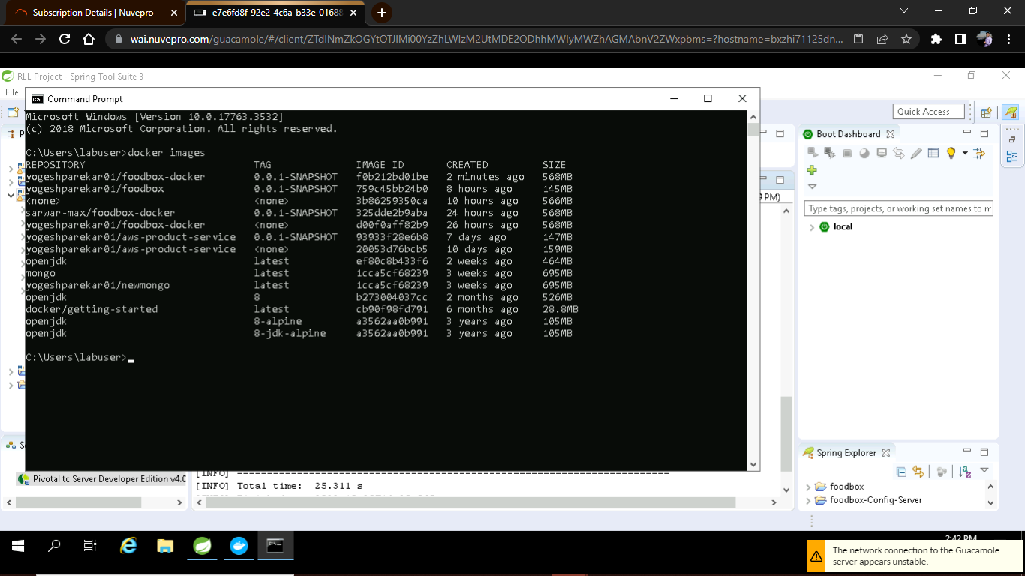
Docker Engine Started
Docker Images

Slide 26
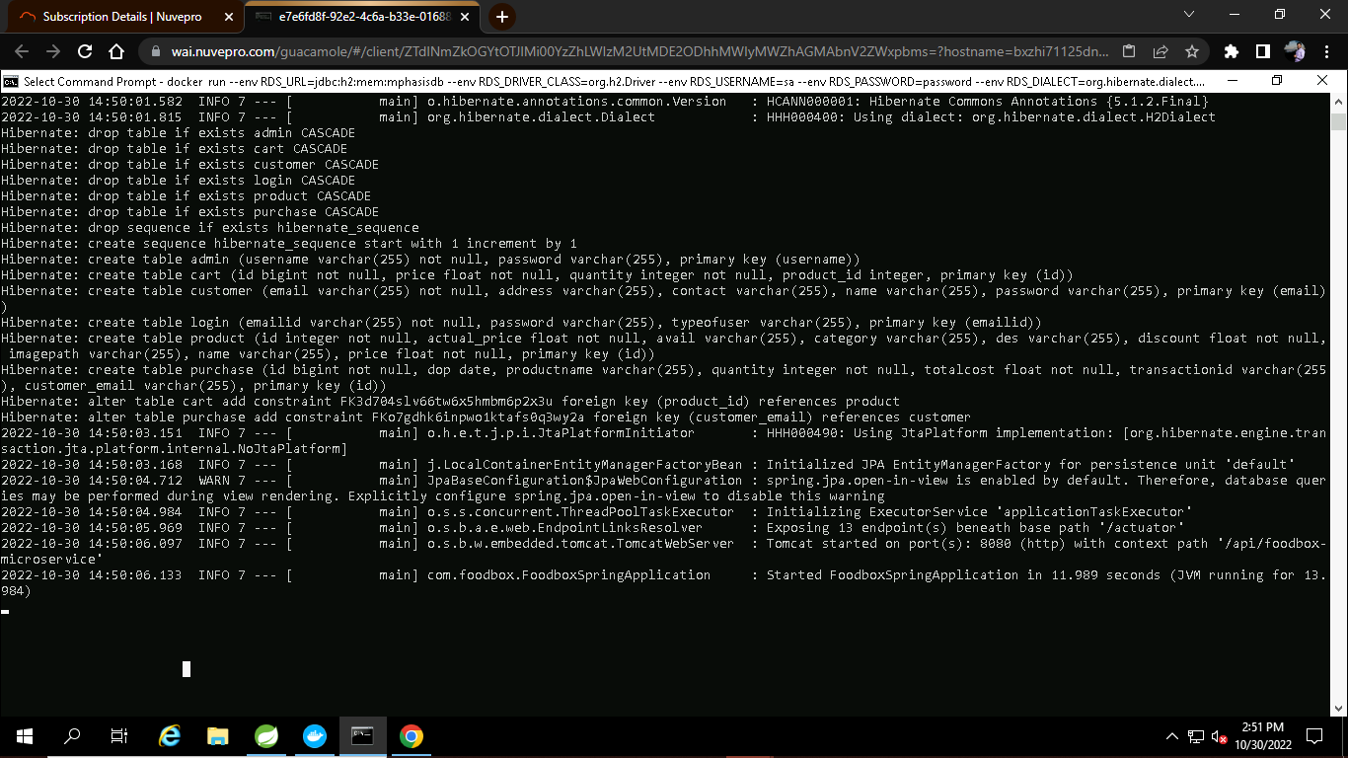

Slide 27
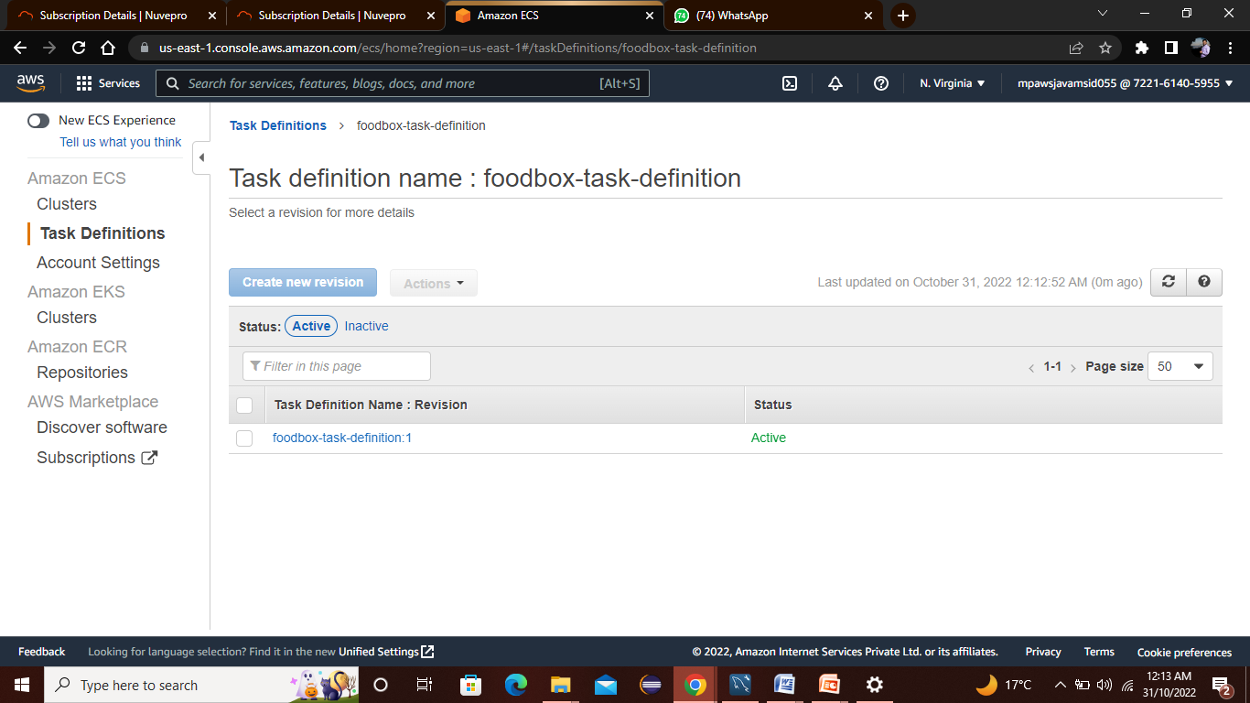
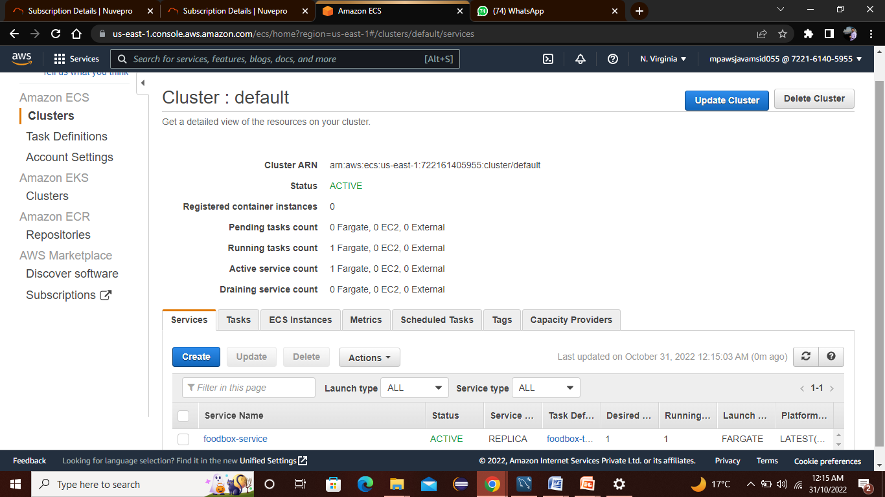
Create Cluster:
Task Definitions for Amazon ECS:

Slide 28
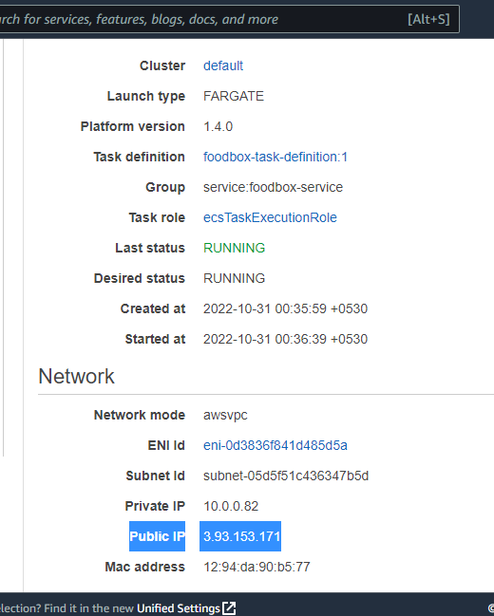
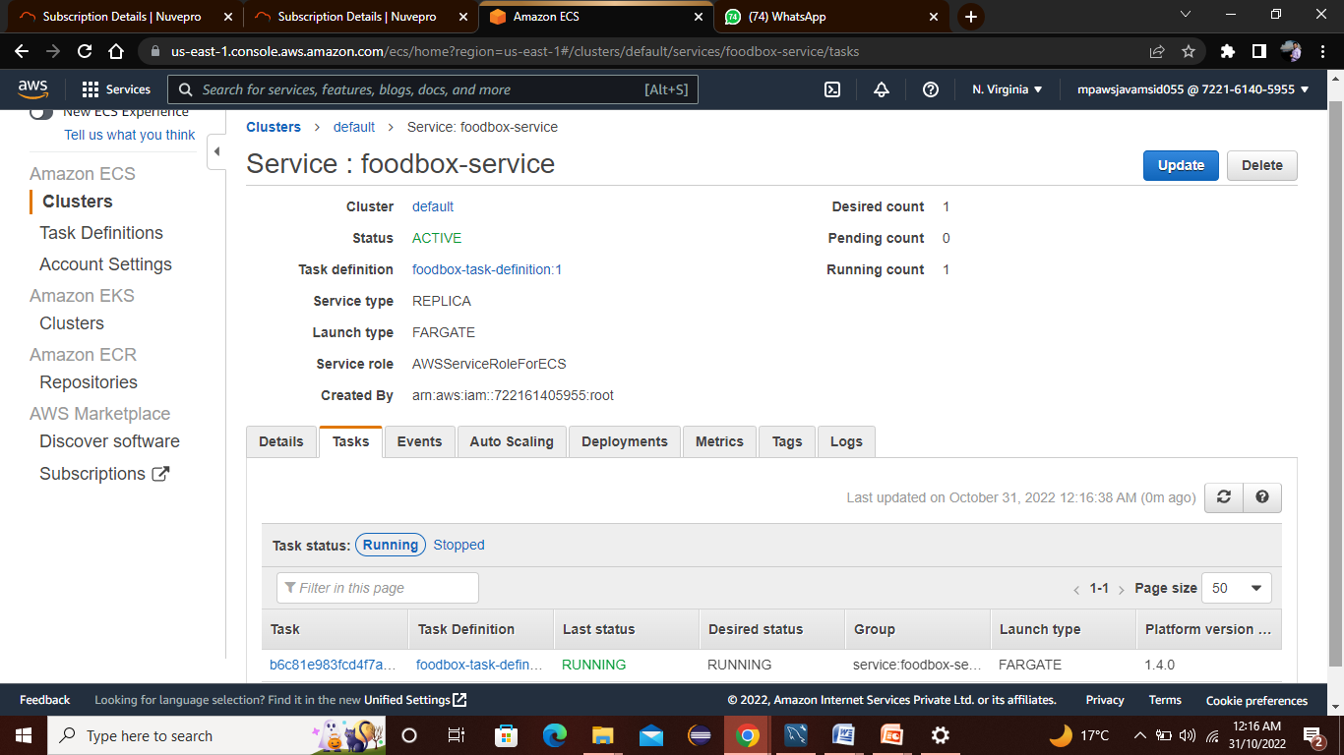
Public IP
Create Service:

Slide 29
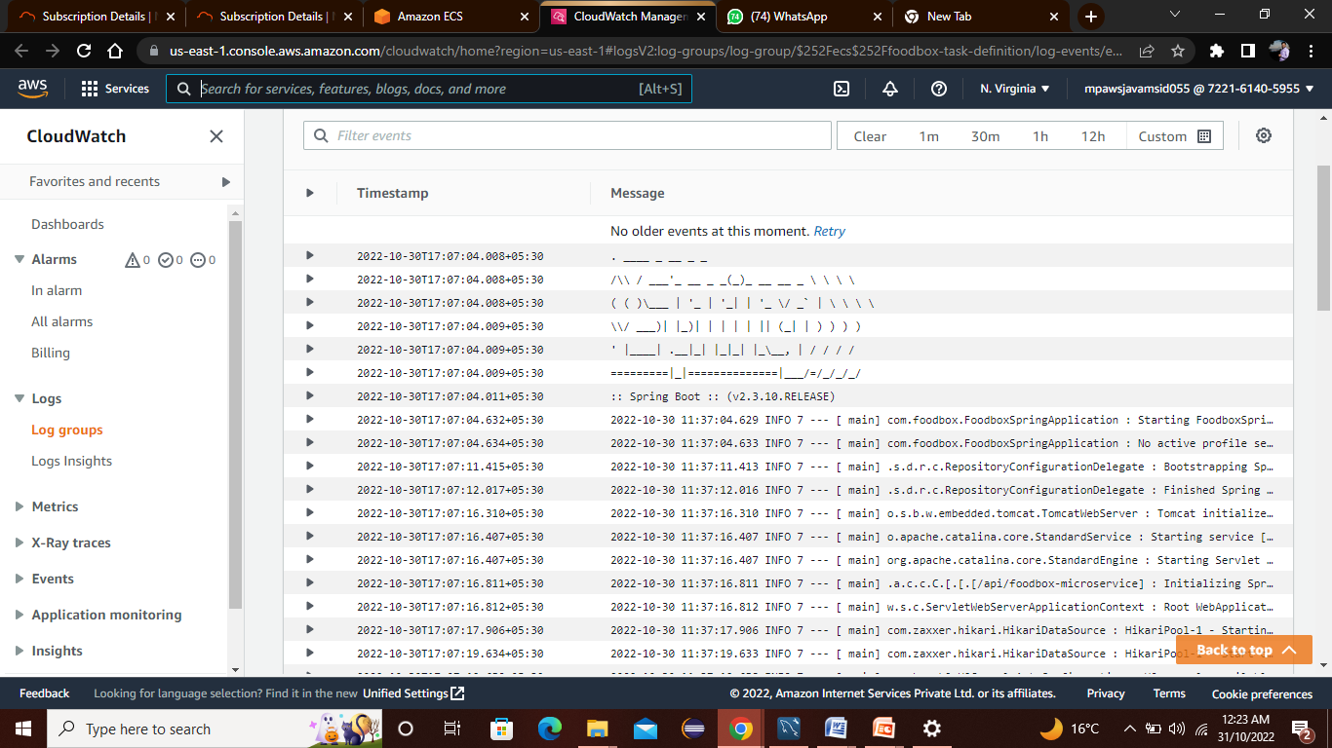
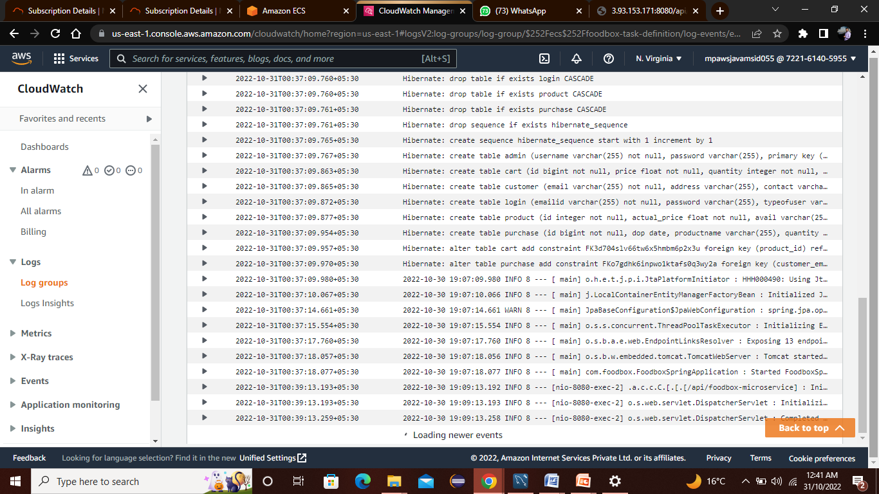
View logs in CloudWatch:

Slide 30
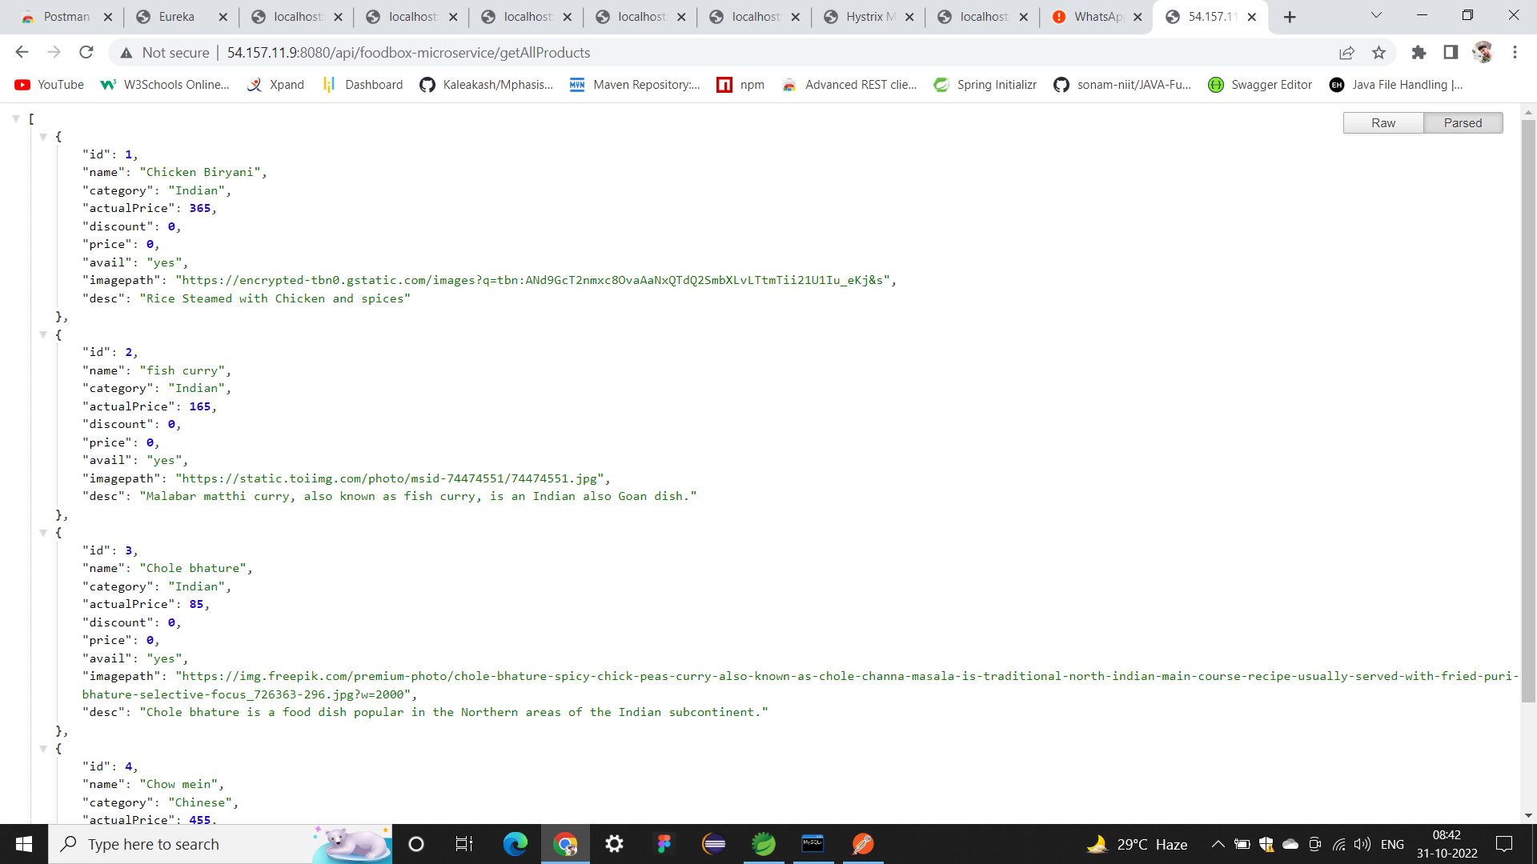
AWS output (using public IP in browser)

Slide 31
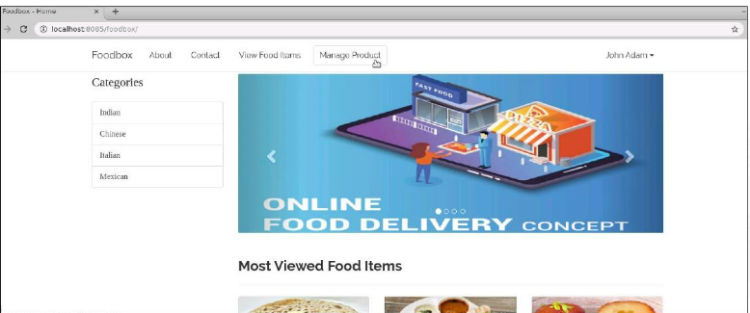

Slide 32
ADVANTAGES
1.Urban Restaurants, Reach Out to Remote Foodies
You captured the foodies of the complete city! Are you sure? Why not extend out the reach to the remote foodies.
2. Pinchpenny? Get Cashback
You love the restaurant food but you want to save money as well, don’t worry. We have got discounts for you.
3. Reserve that Quiet Side Table for Your Next Gathering
Tired of facing the problem of last-minute bookings and cancellations of the tables at the time of your gatherings.
4. Save Your Hard-earned Money, Order food with Discounted Deals
Without having a unique idea, it becomes challenging succeed in this competitive market. Especially in the food delivery industry, it comes difficult to earn people’s trust.

Slide 33
FUTURE WORK
Some of the modules can be implemented such as:
1) Feedback module
2) Product Reviews
3) Customer Complaints
4) Product Location Tracking

Slide 34
CONCLUSION
An online food ordering system is developed where the customers can make an order for the food and avoid the hassles of waiting for the order to be taken by the waiter.
Using the application, the end users register online, read the E-menu card and select the food from the e-menu card to order food online. Once the customer selects the required food item the chef will be able to see the results on the screen and start processing the food.
To provide a bug-free Online Food Delivery system to Users as well as Admin.The main objective is here to provide a nice and secure platform for Ordering Food.To maintain the records of Product, Category available into the system.

Slide 35
THANK YOU

